Slide 1
Technology stocks v. benchmark
Jay Sampat
Data Wrangling Project
Fall 2023, Mod 1

Slide 2





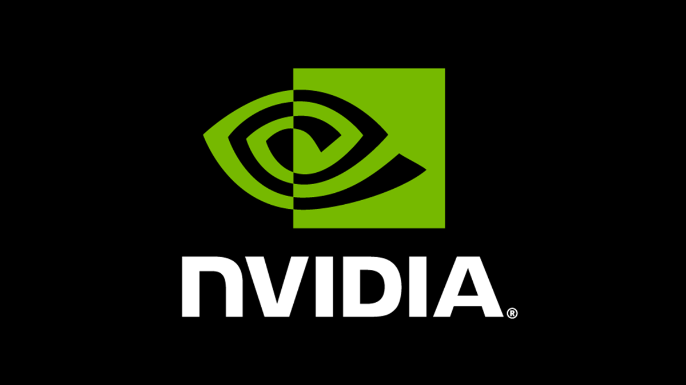
How do the 5 largest* tech stocks compare to the S&p500 over the last 5 years?

Slide 3
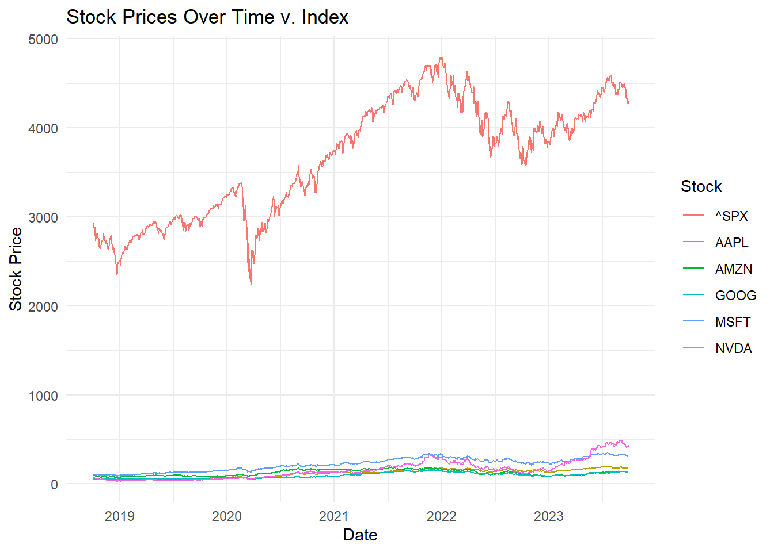
3

Slide 4
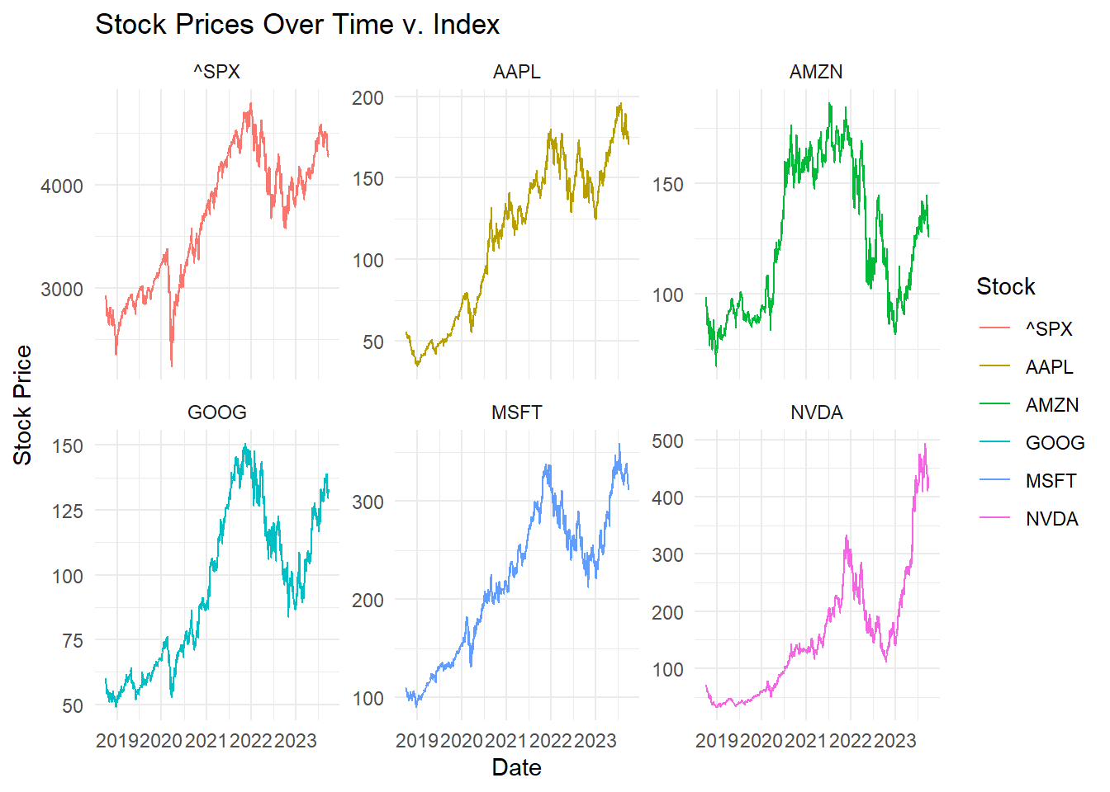

Slide 5
Summarized Mean and Stdev Statistics:
Name | Daily_M_Ret | Stdev | Ann_M_Ret | Ann_Stdev
AAPL | 0.11% | 0.02 | 41% | 0.40
AMZN | 0.05% | 0.02 | 17% | 0.44
GOOG | 0.08% | 0.02 | 30% | 0.39
MSFT | 0.10% | 0.02 | 38% | 0.38
NVDA | 0.20% | 0.03 | 74% | 0.65

Slide 6
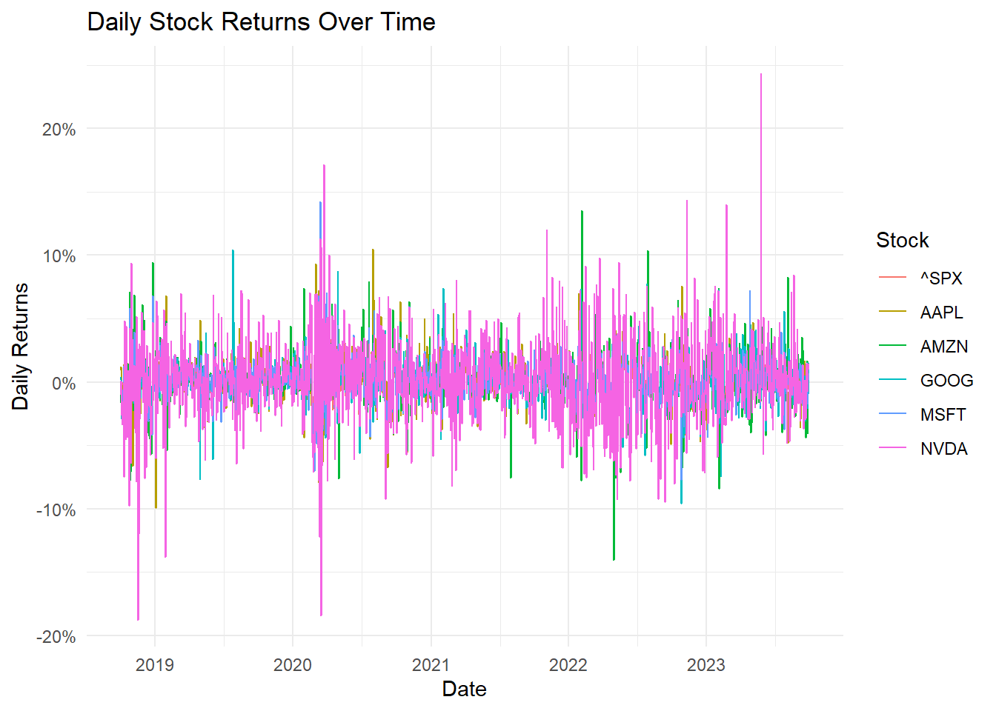

Slide 7
Which Stocks Beat the Market?
Name | Daily_M_Ret | Stdev | Ann_M_Ret | Ann_Stdev
AAPL | 0.11% | 0.02 | 41% | 0.40
AMZN | 0.05% | 0.02 | 17% | 0.44
GOOG | 0.08% | 0.02 | 30% | 0.39
MSFT | 0.10% | 0.02 | 38% | 0.38
NVDA | 0.20% | 0.03 | 74% | 0.65
^SPX | 0.04% | 0.01 | 15% | 0.26

Slide 8
By How Much?
Name | Daily_M_Ret (%) | Stdev | Ann_M_Ret (%) | Ann_Stdev | Beat_By_Ann
AAPL | 0.11 | 0.02 | 41 | 0.40 | 26%
AMZN | 0.05 | 0.02 | 17 | 0.44 | 2%
GOOG | 0.08 | 0.02 | 30 | 0.39 | 15%
MSFT | 0.10 | 0.02 | 38 | 0.38 | 23%
NVDA | 0.20 | 0.03 | 74 | 0.65 | 59%
^SPX | 0.04 | 0.01 | 14 | 0.26 | 0%

Slide 9
Over 5 Years?
Avg 5-year return for Top 5: 201%, 5 Stocks beat market by: 25.5%, on average, yearly
Name | Daily_M_Ret (%) | Stdev | Ann_M_Ret (%) | Ann_Stdev | Beat_By_Ann(%) | Expected 5-year_Returns
AAPL | 0.11 | 0.02 | 41 | 0.40 | 26 | 205%
AMZN | 0.05 | 0.02 | 17 | 0.44 | 2 | 85%
GOOG | 0.08 | 0.02 | 30 | 0.39 | 15 | 150%
MSFT | 0.10 | 0.02 | 38 | 0.38 | 23 | 190%
NVDA | 0.20 | 0.03 | 74 | 0.65 | 59 | 370%
^SPX | 0.04 | 0.01 | 14 | 0.26 | 0 | 73%

